Slide 1
SOP of Installing the Drivers
September, 2013

Slide 2
Step 1
Extract the attached to the D:\CET\iEMS\Common folder
Navigate to D:\CET\iEMS\Common, run the DeviceInstall.exe program

Slide 3
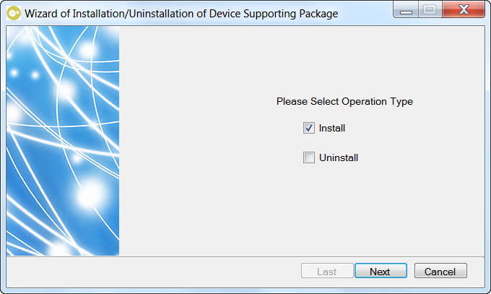
Select Install and click Next.

Slide 4
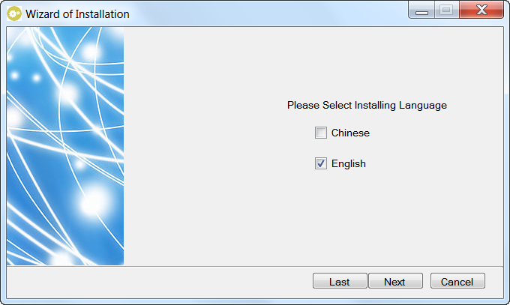
Select English and click Next.

Slide 5
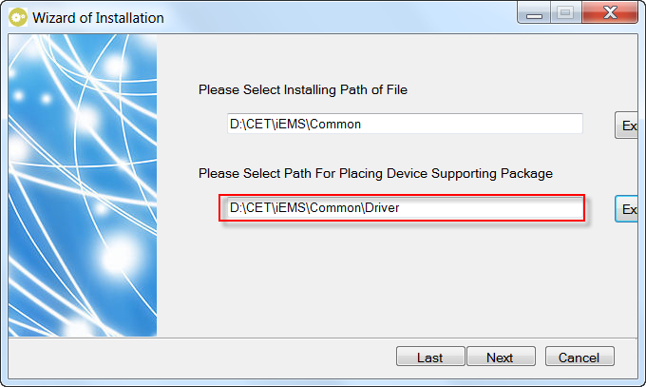
Click Explore… and select the driver folder.

Slide 6
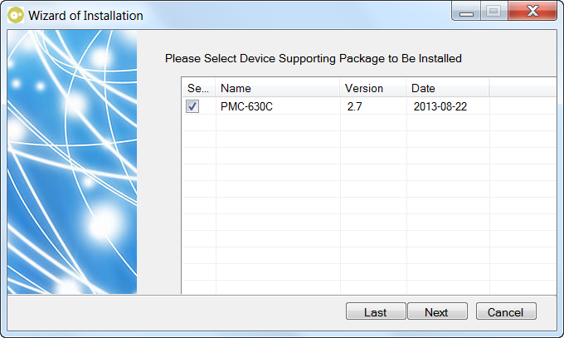
Check the device type and click Next.

Slide 7
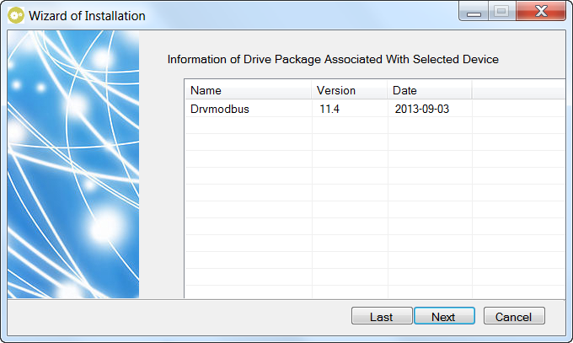
The protocol driver for the device is identified automatically. Click Next.

Slide 8
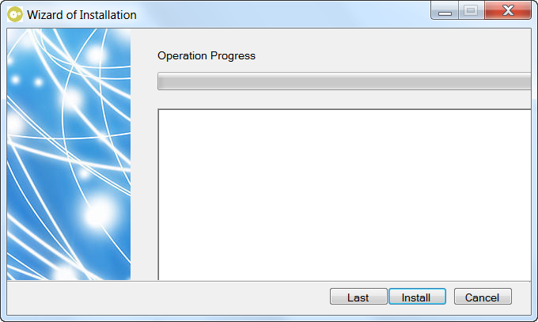
Click Install.

Slide 9
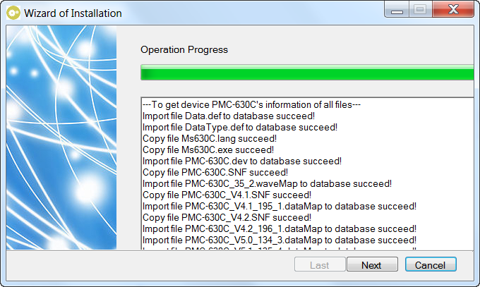
Click Next.

Slide 10
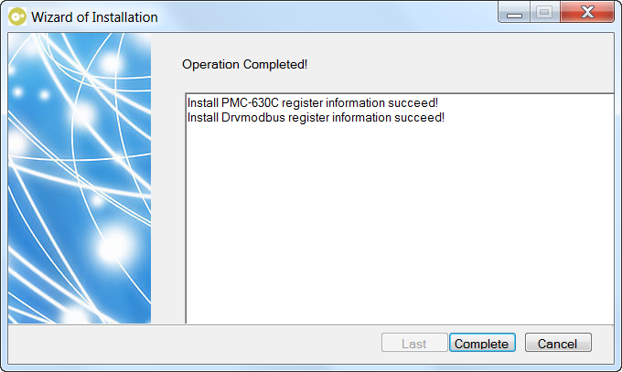
Click Complete. The device driver is installed and then the program is shut down.

